Slide 1

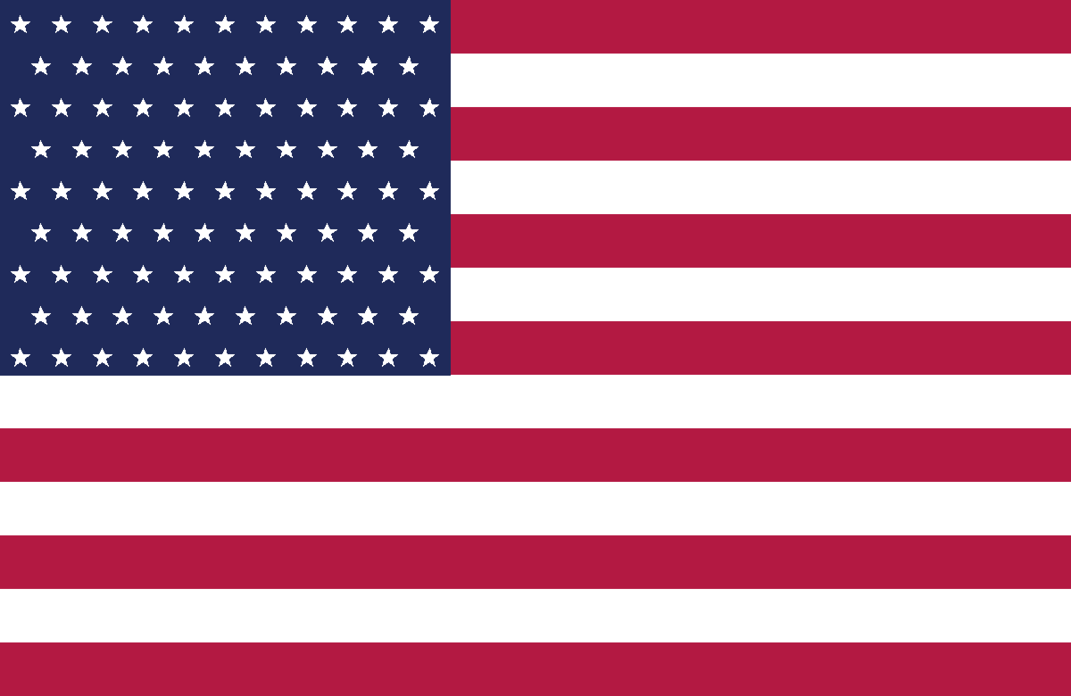
ENGLISH AS A
GLOBAL LANGUAGE
A Case Study of the United States of America
Culture • The Arrival of English • American vs British English
Presented by: [MINH TAM] [THANH THUY] [MINH TAN]
Course: English as a Global Language | Instructor: [Name] | Duration: ~15 minutes
Notes:
[Opening ~45s | all] Welcome, introduce the three presenters, state the topic and preview the three parts.

Slide 2




Presentation Roadmap
01
02
03
English:
From Britain to the World
American English
& American Culture
American vs
British English
History • word origins • global spread • Kachru’s circles • first footsteps in America
Isolation • Webster • melting pot • Thanksgiving • Independence Day
Pronunciation • vocabulary • grammar • spelling
▶ [MINH TAN] • Slides 3–8
▶ [THANH THUY] • Slides 9–14
▶ [MINH TAM] • Slides 15–19
~15 min • 3 presenters • 21 slides
Notes:
[~45s | all] Walk through the three parts, each about five minutes, and who presents each one.

Slide 3

01
English: From Britain to the World
History, word origins, global spread — and the first steps into America
Presented by [MINH TAN]
Notes:
[Member 1 begins ~5 min] Set up: how English grew from a small Germanic language into a world language, and how it first crossed the Atlantic.

Slide 4



A Short History of English
1066 — the Norman Conquest — is the single most important turning point in the history of English.
Old English
Middle English
Early Modern
Modern English
5th c. – 1066
1066 – 1450
1450 – 1700
1700 – now
Germanic tribes (Angles, Saxons, Jutes) settle Britain
Norman Conquest brings heavy French & Latin influence
Great Vowel Shift; printing press (1476); Shakespeare
Standardised and spread worldwide as a global language
Source: Crystal (2003)
Notes:
[M1 ~1 min] Four stages. Two turning points: 1066 (French & Latin vocabulary) and 1476 printing press + the Great Vowel Shift.

Slide 5



Why & How English Went Global
From 6 million to 1.5 billion speakers
British Empire
Colonies (17th–20th c.) planted English worldwide.
Rise of the USA
Post-WWII economy + Hollywood, music and TV.
The Internet Age
US-led digital technology made English the default online.
English is now the working language of the UN, the EU and NATO.
Estimates: Crystal (2003); Ethnologue (2026)
Notes:
[M1 ~1.5 min] English is global because of history, not superiority. Two forces: the Empire planted it, the USA modernised it. Point at the chart: from about 6 million speakers in 1600 to roughly 1.5 billion today. Note these are approximate estimates.

Slide 6


The First Footsteps American English (17th Century)
≈ 3,000 miles of ocean
Britain
North America
Colonial Implantation
Linguistic Preservation
In 1607 (Jamestown) and 1620 (Plymouth), British settlers transplanted their language to North America — the Early Modern English of the Shakespearean era.
While British English kept changing at home, the settlers preserved older, Elizabethan features that Britain later dropped.
1607 — Jamestown, Virginia
Rhoticity — Pronouncing the /r/ sound clearly
1620 — Plymouth, Massachusetts
Vocabulary — Keeping older words such as “fall” (autumn)
Sources: History.com (2025); Library of Congress
Notes:
[M1 ~1 min | NEW | end of Part 1] The English that crossed the Atlantic was Shakespeare's English. Two ideas: implantation (1607, 1620) and preservation — America kept features Britain later lost, such as the strong /r/ and the word 'fall'. Hand over to Member 2.

Slide 7

Where Does American English Sit?
Kachru’s Three Concentric Circles (1985)
Inner Circle
Expanding Circle
English as a native language (L1). Norm-providing.
e.g. USA, UK, Canada, Australia
Outer Circle
Outer Circle
English as a second language, colonial history.
e.g. India, Singapore, Philippines
INNER
Expanding Circle
USA · UK
English as a foreign language.
e.g. Vietnam, China, Japan, Korea
★ The USA is in the INNER CIRCLE — a native, norm-providing variety, alongside the UK.
Source: Kachru (1985); Al-Mutairi (2020)
Notes:
[M1 ~1 min] Explain the three circles. Answer the question: the USA is in the Inner Circle — native and norm-providing.

Slide 8
02
American English & American Culture
How American English became distinct — and the culture it grew in
Presented by [THANH THUY]
Notes:
[Member 2 begins ~5 min] Continue the story: separated by an ocean, English in America went its own way. Then look at the culture around it.

Slide 9

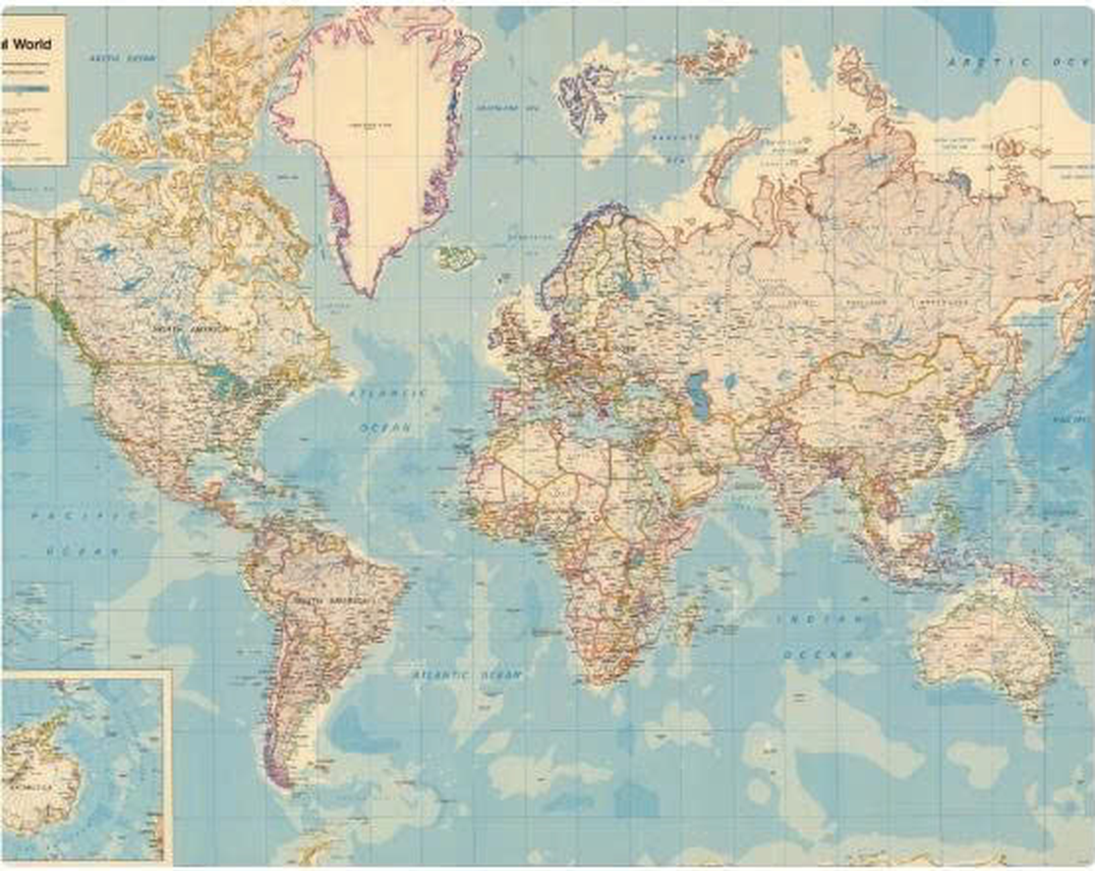

Isolation and Adaptation (18th Century)
3,000
miles of ocean between London and the colonies — no daily contact, no shared updates.
Geographic Isolation
The ocean cut off daily linguistic contact with London. American English was free to develop on its own.
Adapting to the Wilderness
Colonists met new landscapes, wildlife and plants that had no English names — so new words were needed.
An 18th-century world map — the Atlantic as a linguistic wall.
New words from the new world: moose · raccoon · skunk · prairie · canyon
Part 2 • [Member 2]
Notes:
[M2 ~1.5 min | NEW] Two forces made American English diverge. First, isolation: 3,000 miles of ocean meant no daily contact with London. Second, adaptation: settlers needed brand-new words for a brand-new environment — moose, raccoon, prairie.

Slide 10

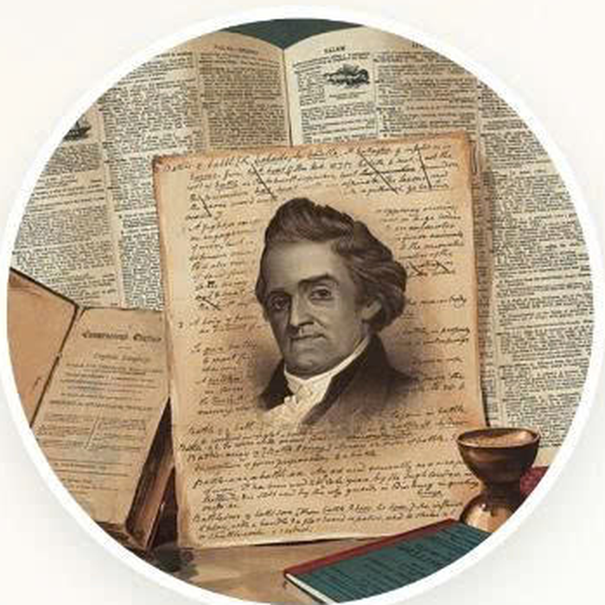
Linguistic Independence (1828)
Noah Webster (1828)
Noah Webster’s Revolution
After the American Revolution of 1776, the new nation wanted intellectual independence too. Webster simplified spelling deliberately — turning the dictionary into a symbol of cultural independence from Britain.
Spelling transformed
colour (UK)
→ color (US)
theatre (UK)
→ theater (US)
travelling (UK)
→ traveling (US)
defence (UK)
→ defense (US)
Noah Webster — An American Dictionary of the English Language (1828)
Political independence in 1776 → linguistic independence in 1828.
Source: Webster (1828); Wikipedia (2026)
Notes:
[M2 ~1.5 min | NEW] Webster is the key figure. After political independence in 1776, America wanted linguistic independence too. He deliberately simplified spelling: colour became color, theatre became theater. This is why the two spelling systems differ today — and it sets up Part 3.

Slide 11




American Culture: A Melting Pot
Cuisine
Immigration also fed the language
Burgers and hot dogs alongside Italian, Mexican, Chinese and regional cooking (BBQ, Tex-Mex, Cajun).
Native American moccasin · raccoon
Religion
Spanish canyon · ranch · rodeo
One of the most religiously diverse nations; freedom of religion is protected by the First Amendment.
Dutch cookie · boss · coleslaw
German kindergarten · hamburger
Festivals
Religious, harvest and patriotic holidays — led by two uniquely American ones.
Italian pizza · spaghetti
Yiddish bagel · klutz
Every wave of immigrants left words behind.
Part 2 • [Member 2]
Notes:
[M2 ~1 min] The USA is a melting pot — cuisine, religion, festivals. And crucially, every immigrant group also left words behind: raccoon, canyon, cookie, kindergarten, pizza, bagel. Culture and language grew together.

Slide 12





A Harvest of Gratitude
Origin – 1621
Modeled on a harvest feast shared by the Plymouth Pilgrims and the Wampanoag people.
National holiday – 1863
President Lincoln made it national during the Civil War; fixed to the 4th Thursday in 1941.
THANKSGIVING
The tradition today
4th Thursday of November
A family meal of turkey, mashed potatoes, cranberry sauce and pumpkin pie; parades & football.
A second perspective
For many Native Americans it is a ‘National Day of Mourning’, recalling colonisation.
Sources: Britannica (2026); Nat. Archives
Notes:
[M2 ~1 min] The 1621 feast, then national holiday in 1863. Today: turkey, family, parades, football. Add the Native American perspective — the National Day of Mourning.

Slide 13



INDEPENDENCE DAY
The Fourth of July — America’s birthday
July 4, 1776
How it’s celebrated
What it means
The thirteen colonies adopt the Declaration of Independence, breaking from Great Britain.
Fireworks, parades, concerts, barbecues and the red-white-and-blue everywhere.
The central patriotic holiday — nationhood, freedom and civic identity.
Thanksgiving = family & gratitude • Independence Day = nationhood & freedom
Notes:
[M2 ~1 min | end of Part 2] Contrast the two festivals: family & gratitude vs nationhood & freedom. Then hand to Member 3, who will show exactly how American English differs from British English.

Slide 14

03
American vs British English
Four systematic differences — with clear examples
Presented by [MINH TAM]
Notes:
[Member 3 begins ~5 min] Preview: pronunciation, vocabulary, grammar, spelling. These are variations within ONE mutually intelligible language.

Slide 15

1. Pronunciation & Phonetics (IPA)
Rhoticity
Word | UK (RP) | US (GenAm)
Car | /kɑː/ | /kɑːr/
Water | /ˈwɔːtə/ | /ˈwɔːɾər/
Dance | /dɑːns/ | /dæns/
Tomato | /təˈmɑːtəʊ/ | /təˈmeɪtəʊ/
Schedule | /ˈʃedjuːl/ | /ˈskedʒuːl/
Vitamin | /ˈvɪtəmɪn/ | /ˈvaɪtəmɪn/
US pronounces every ‘r’ (car /kɑːr/); UK often drops it (/kɑː/).
The ‘flap’ T
US turns t between vowels into a quick /ɾ/ — water ≈ ‘wa-der’.
BATH vowel
dance, bath, grass: /ɑː/ in UK vs /æ/ in US.
Source: Cambridge Dictionary
Notes:
[M3 ~1.5 min] Demonstrate rhoticity (car) and the flap-T (water) out loud. Read a couple of IPA rows in both accents.

Slide 16

2. Vocabulary
Hundreds of everyday words differ — usually understood from context.
British English | American English | British English | American English
flat | apartment | petrol | gas / gasoline
lift | elevator | autumn | fall
boot (car) | trunk | biscuit | cookie
pavement | sidewalk | chips | fries
underground / tube | subway | holiday | vacation
football | soccer | rubbish | garbage / trash
Sources: VOA (2017); Wikipedia (2026)
Notes:
[M3 ~1 min] Pick fun pairs: flat/apartment, chips/fries, football/soccer. Meaning is usually clear from context.

Slide 17

3. Grammar
Fewer differences than vocabulary — and fewer in writing than in speech.
Feature | British English | American English
Present perfect vs past simple | I have just eaten. | I just ate.
Past participle of ‘get’ | got | gotten
Collective nouns | The team are playing. | The team is playing.
Lack of obligation | You needn’t come. | You don’t need to come.
Preposition of time | at the weekend | on the weekend
Possession | Have you got a pen? | Do you have a pen?
Sources: British Council (2020); Cambridge
Notes:
[M3 ~1 min] Highlight 'gotten' and collective nouns (team are vs team is).

Slide 18

4. Spelling
Many patterns trace back to Noah Webster’s 1828 dictionary.
Pattern | British English | American English
-our → -or | colour, honour, favour | color, honor, favor
-re → -er | centre, theatre, metre | center, theater, meter
-ise → -ize | organise, realise | organize, realize
double ‘l’ → single | travelled, cancelled | traveled, canceled
-ogue → -og | catalogue, dialogue | catalog, dialog
-ence → -ense | defence, licence | defense, license
Source: Wikipedia (2026); Oxford Intl. English
Notes:
[M3 ~1 min | end of Part 3] Regular patterns — drop the u, flip -re to -er, prefer -ize. Credit Noah Webster again (Member 2 introduced him).

Slide 19

Conclusion — Key Takeaways
History, not superiority
English is global because of the British Empire and US power — and the USA sits in Kachru’s Inner Circle.
Isolation, adaptation, independence
The Atlantic, a new environment and Noah Webster made American English distinct.
One language, two varieties
American and British English differ in sound, words, grammar and spelling — but remain mutually intelligible.
Future studies: compare Outer-Circle varieties (Indian, Philippine English) or how US media shapes English for learners in Vietnam.
Notes:
[All / Member 1 ~1 min] Recap the three takeaways, point to future directions, invite questions.

Slide 20

Thank You!
Questions & Answers
[MINH TAN] • [THANH THUY] • [MINH TAM]
Full references (Harvard style) are provided in the accompanying essay.
Notes:
[All ~30s] Thank the audience. Q&A split: M1 = language/history, M2 = American English history & culture, M3 = the comparison.

